Slide 1




Research towards virtual human twins
Marian Bubak
Marek Kasztelnik, Maciej Malawski, Jan Meizner, Piotr Nowakowski, Piotr Połeć
Laboratory of Informatics Methods in Medicine, ACC Cyfronet AGH
Sano Centre for Computational Medicine
Krakow, Poland
http://www.dice.cyfronet.pl/ , https://sano.science/
KUKDM Conference, Zakopane, 13-15 March 2024

Slide 2
Outline
Virtual Physiological Human (VPH), digital twin, Virtual Human Twin (VTH)
Motivation
VHT from computer science perspective
Features of the platform for VHT
Demonstrator architecture
Example application
Summary and future work

Slide 3
VPH, digital twin, Virtual Human Twin
VPH - Virtual Physiological Human, sometimes in silico medicine - a field involving the use of individualized computer simulations based on physiology in aspects of prevention, diagnosis, prognostic assessment and treatment of disease and biomedical product development
A digital twin - a digital representation of a physical object, person or process, placed in context in a digital version of its environment
VHT - virtual human twin - an integrated, multi-scale, multi-temporal and multi-disciplinary representation of quantitative human physiology and pathology (EDITH project definition)

Slide 4
Role of VHT
Vision: digital twins of humans, from cells and tissues to organs and entire bodies
A digital twin may help to
predict the risk of disease,
plan and control medical treatment,
take part in virtual drug tests,
propose changes in diet and lifestyle,
identify therapies that improve well-being and prolong life
With VHT a real personalised medicine may be possible

Slide 5
Selected institutions and projects in ​​computational medicine
VPH Institute - https://www.vph-institute.org/ an international non-profit organization whose mission is to ensure that VPH is fully realized, widely adopted and used effectively in both research and clinics
CompBioMed - https://www.compbiomed.eu/ Center of Excellence financed by the European Commission (H2020), focused on the use and development of computational methods in biomedical applications
EDITH - https://www.edith-csa.eu/edith/ European Commission project (Digital Europe); its goal is to define a roadmap for moving from single-organ systems to a fully integrated, multi-scale, multi-organ, whole-body twin, driven by data and knowledge
Sano Centre for Computational Personalised Medicine International Research Foundation - https://sano.science/
5

Slide 6
EDITH – European Virtual Human Twin https://www.edith-csa.eu/
EDITH’s main objective: to frame an inclusive ecosystem of digital twins in healthcare within the EU Member States and associated countries through:
a comprehensive roadmap of the current landscape
implementation a federated cloud-based repository
gathering human digital twin resources: models, data sets, algorithms, practices
designing the architecture of a simulation platform to facilitate the transition towards the use of comprehensive Virtual Human Twin (VHT) models in personalised medicine
Main Cyfronet task: elaboration of a demonstrator of such a simulation platform.

Slide 7
VHT from computer science perspective
A set of software modules implementing human physiology models which can simulate human body processes
A set of data which represents the specific patient in relation to a specific condition or treatment process
Simulation modules may be run on different compute resources: local servers, clouds, HPC.
The data is not typically restricted in any manner, it may include:
unstructured textual data
binary data
structured repositories
free-text descriptions

Slide 8
Basic VHT requirements
A system agnostic to the supported classes and formats of data items, to support a comprehensive data repository where various data items may be queried, retrieved and fed into the computational models which constitute the simulation workflow
Access to a computational infrastructure such as:
standalone servers for small-scale simulations
cloud computing infrastructures for simulations in which a moderately sized set of data is processed using complex algorithms
High Performance Computing for scale-out studies which involve processing large amounts of data and “parameter study” types of computations

Slide 9
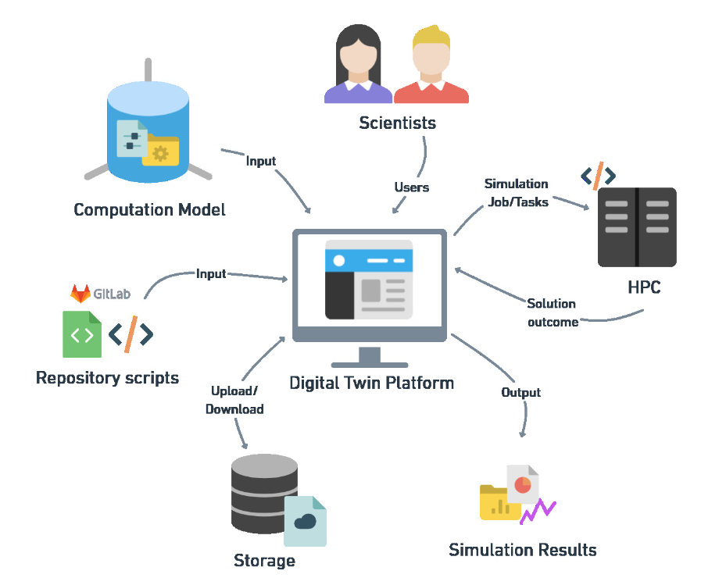
Platform features (1/2)
Model versioning - previous versions of the model are stored and may be referred to if needed
Repeatable runs
Repeatability – same team, same experimental setup; a researcher can reliably repeat own computation
Replicability - different team, same experimental setup; an independent group can obtain the same result using the author’s own artifacts
Reproducibility - different team, different experimental setup; an independent group can obtain the same result using artifacts which they develop completely independently

Slide 10
Platform features (2/2)
Coherent and manageable to enable a group of scientists with various backgrounds to run digital experiments
The system should enable execution of computational models controlled by a set of scripts with a versioning system enabling collaborative editing and tagging specific versions that may be later selected to suit the researchers’ need
The system should allow streamline access to compute infrastructures
Models need to operate on data stored in a storage backend
The platform should provide a straightforward way to display, download and analyze simulation results

Slide 11
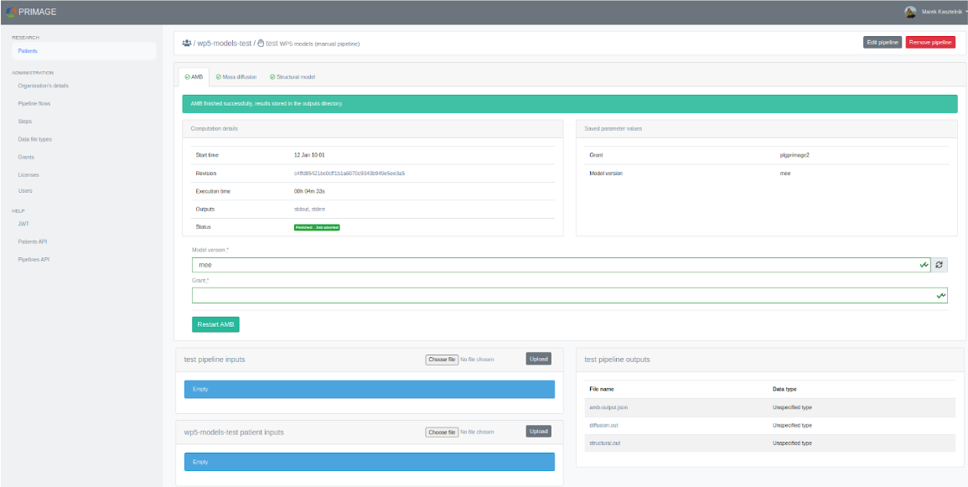
EDITH demonstrator – extended MEE
Model Execution Environment (MEE) is a specialized HPC high-level service to manage data and computations in the context of a patient cohort
MEE is the result of EurValve, PRIMAGE, and In Silico World (ISW) EU projects
In EDITH MEE was extended based on requirements of a set of models and applied to validate virtual human twin idea
MEE hides the complexity of the underlying infrastructure and introduces a unified way for patient/case data to be stored and maintained

Slide 12
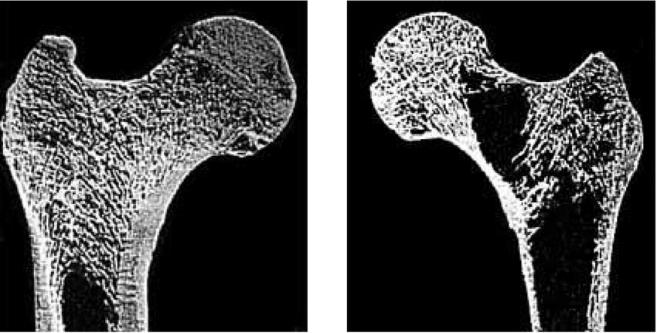
Usage example - the BoneStrength application
Osteoporosis: bone metabolism disorder; causes bone mineral mass loss, bones become more fragile and prone to fracture
mainly affects post-menopausal women
about 3M fragility fractures in Europe every year (1-year mortality after fragility fracture at around 20%)
osteoporosis drugs require long times to show effects
Healthy
Osteoporotic

Slide 13

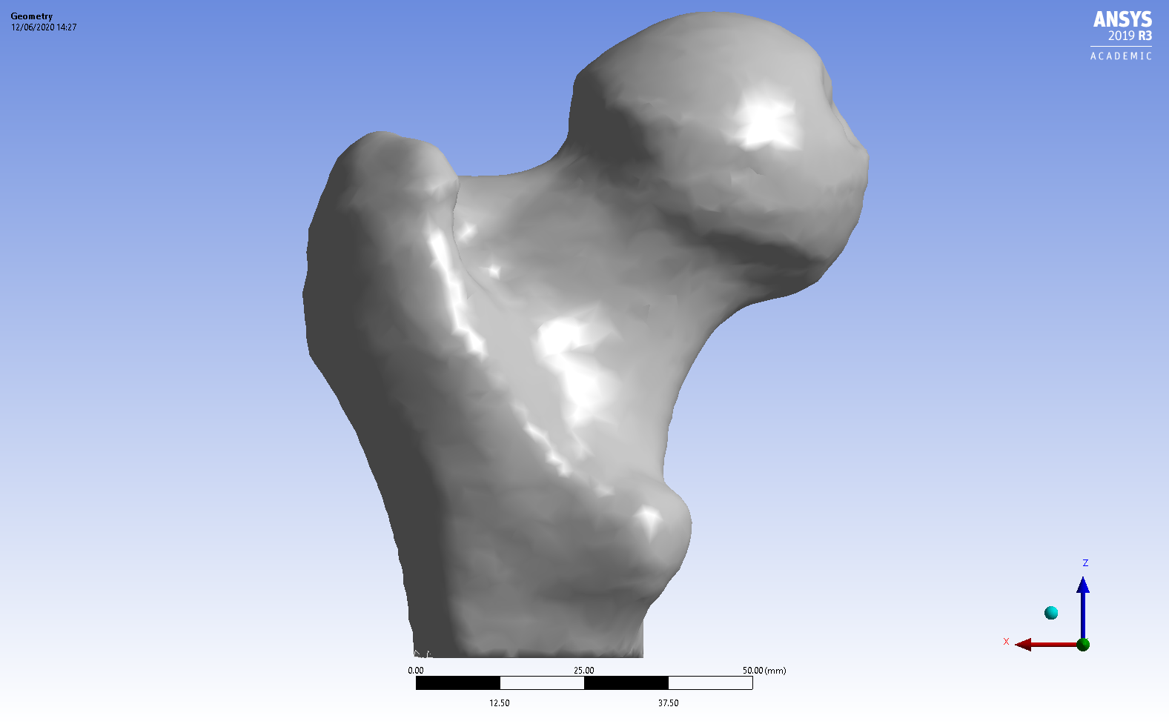
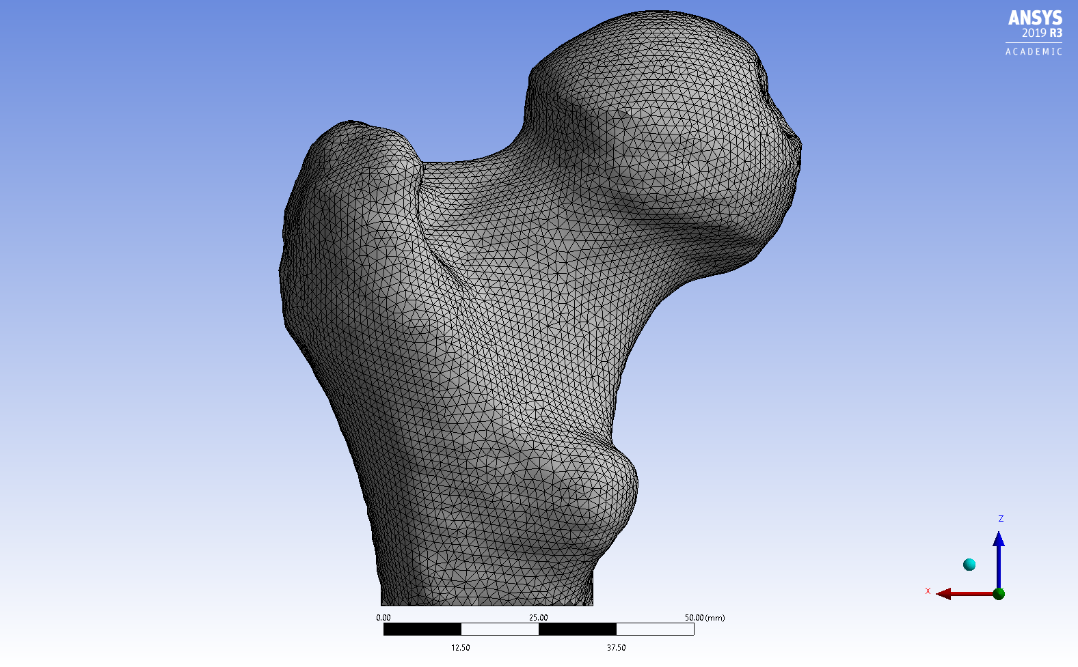
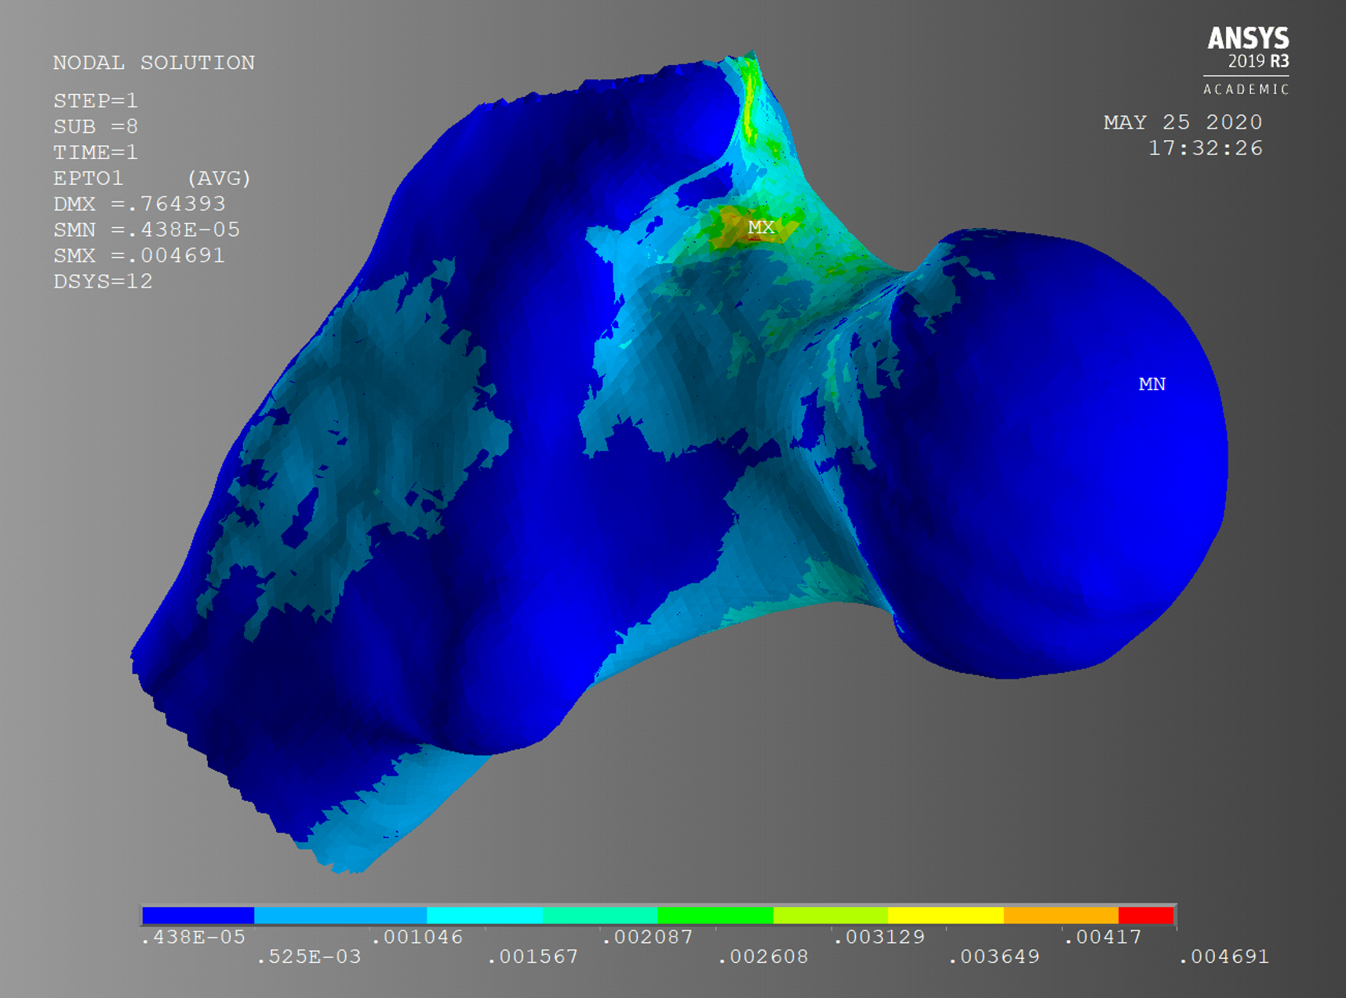

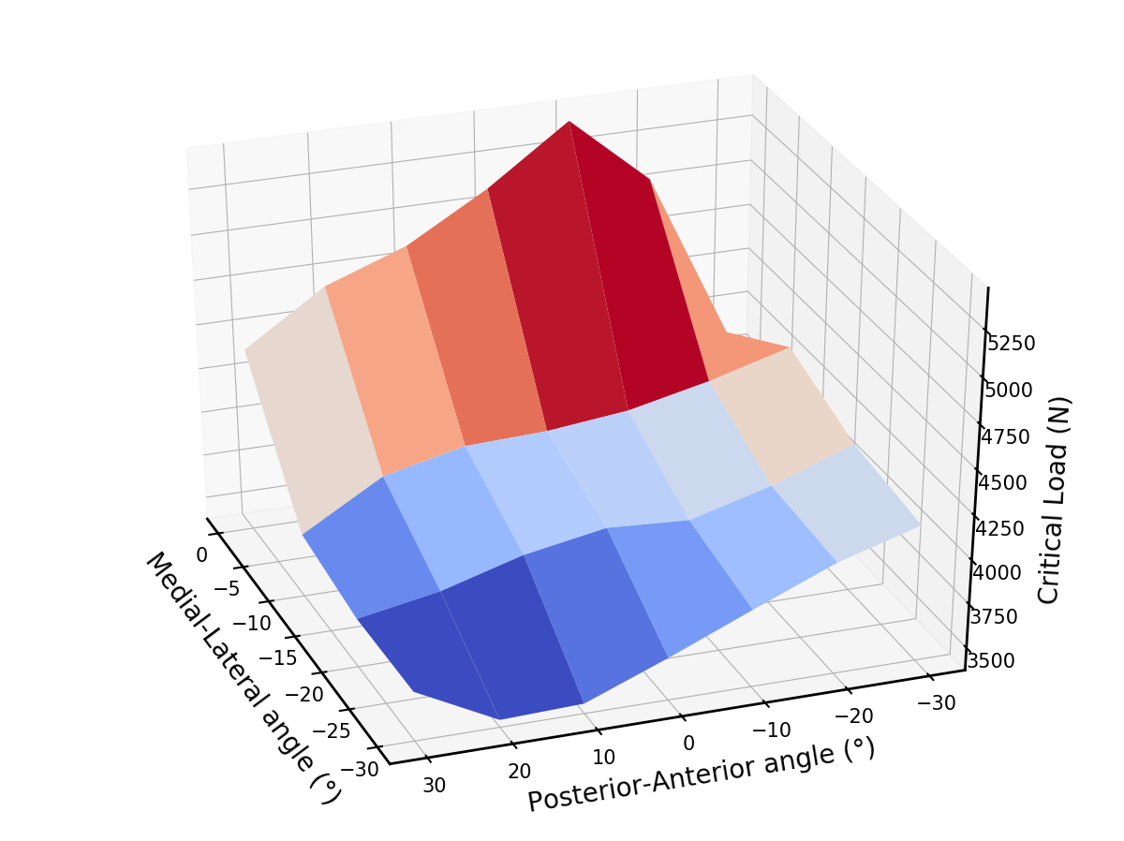
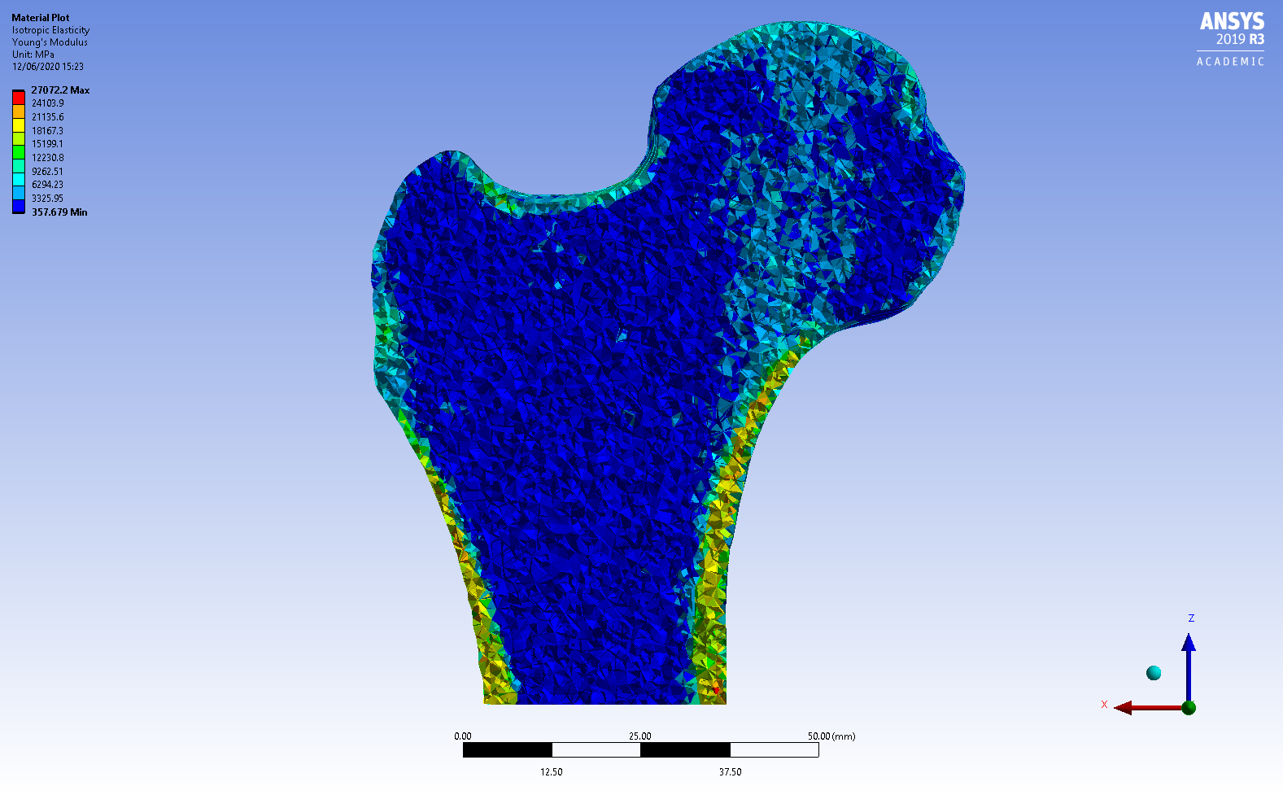
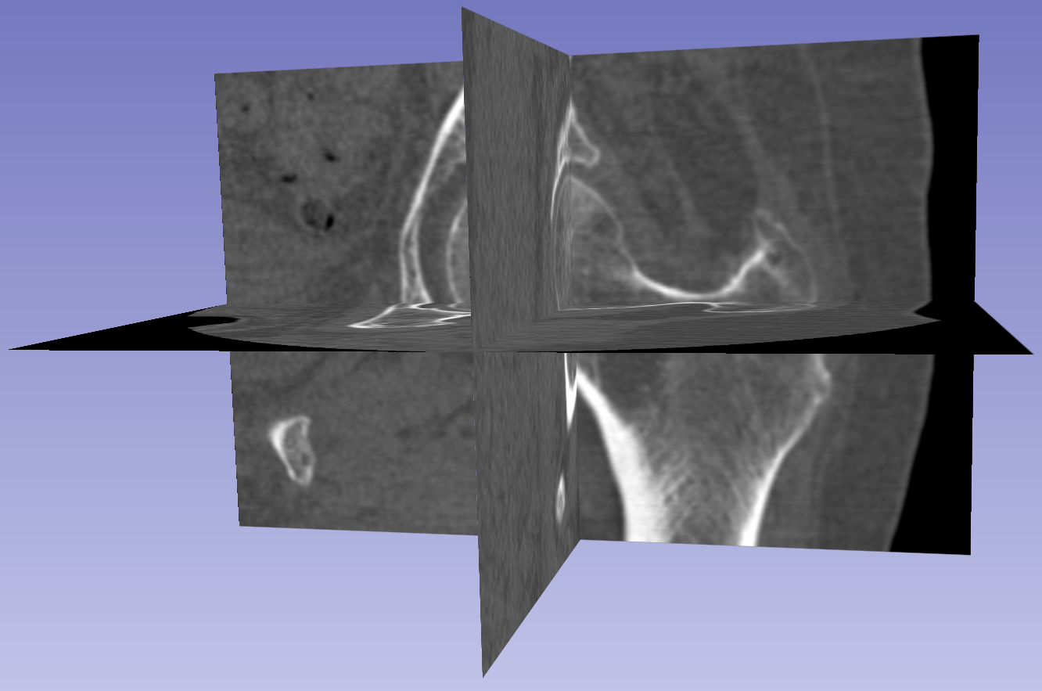

The BoneStrength workflow
HPC facility
Critical load map
3D model
3D mesh
…
Material mapping
Different fall angles
CT scan

Slide 14
The BoneStrength application campaign
The full BoneStrength campaign involved 7628 simulated falls
Each fall requires between 1 and 2 hours to simulate to completion on a cluster node, HPC computing was provided by the Ares cluster at ACC Cyfronet
The first cohort (0 g/cc/year) was successfully simulated, obtaining an incidence of 0.66% per year (69 fractures for 1044 patients in 10 years follow up)
For the second cohort (resorption rate of 0.003 g/cc/year) predicted incidence was 0.89% per year (92 fractures for 1035 patients in 10 years follow up, given that for 9 patients simulations failed)
Lastly, in the third cohort (resorption rate of 0.0064 g/cc/year) fracture incidence was 1.13% per year (116 fractures for 1028 patients in 10 years follow up)
In each case, we can successfully simulate at least 1000 patients, which is the common sample size for Phase III clinical trials.

Slide 15
Vision of personalised medicine
Informed, empowered, engaged and responsible citizens
Conscious, empowered, committed and responsible health care providers
Health systems enable personalized, optimized health promotion and disease prevention, diagnosis and treatment for the benefit of patients
Access to health information to optimize treatment, care, prevention and research
Economic value by establishing a new generation of health care
Vicente, A. M., Ballensiefen, W. & Jönsson, J.-I. How personalised medicine will transform healthcare by 2030: the ICPerMed vision. J. Transl. Med. 18, 180 (2020), https://doi.org/10.1186/s12967-020-02316-w

Slide 16
Summary and future work
VHT is a contribution to change medicine from a discipline based on the past experience to medicine led by scientific activities and similar to engineering
Extended MEE as the EDITH demostrator is released on the open-source license - https://gitlab.com/cyfronet/mee)
GEMINI - A Generation of Multi-scale Digital Twins of Ischaemic and Haemorrhagic Stroke Patients: Our role: elaboration of good practices to produce complex medical computer and next simulation experiments with virtual twin models run for a large cohort of patients on the ACC Cyfronet AGH infrastructure
Meetween: new solutions for language-free collaboration between people using comprehensive, integrated algorithmic capabilities offered by fundamental models and self-supervised training on large data sets, and, as a result, we expect that AI solution will considerably enhance virtual human twins

Slide 17
Acknowledgements
EDITH – EU Digital Europe project 101083771
ISW - EU H2000 project 101016503
EU H2020 Teaming Sano No 857533 and FNP IRAP projects
GEMINI - EU Horizon Europe project 101136438
Meetween - EU Horizon Europe project 101135798
Computational grant PLG/2023/016723

Slide 18
Additional reading
EDITH project VHT Roadmap available at https://www.edith-csa.eu/
About virtual human twin in a popular way:
Peter Coveney, Roger Highfield: Virtual You. How Building Your Digital Twin will Revolutionize Medicine and Change Your Life, Princeton University Press, 2023
Marian Bubak, Cyfrowi bliźniacy i medycyna przyszłości, lecture at Copernicus Center, 21.09.2023, available on YouTube via https://sano.science/popularization-of-computational-medicine/
About Sano Centre achievements:
Sano website - https://sano.science/
Tygodnik Powszechny 29.11.2023
Tygodnik Powszechny 13.03.2024

